Slide 1
Innovation Overview
Stephanie Shipp
Gizem Korkmaz
May 31, 2016

Slide 2
From Invention to Innovation
Many definitions - let’s pick two
In OECD’s Oslo Manual, which provides guidelines for collecting and interpreting innovation data, innovation is defined as the implementation of products or production and delivery processes with new or significantly improved characteristics.
  The third edition of the Oslo Manual extends the definition to include new organizational methods in business practices, workplace organization, or external relations (OECD 2005).
DOC defines innovation as the design, development, and implementation of new or altered products, services, processes, organizational structures, and business models to create value for the customer and financial returns for the firm practicing innovation (DOC 2008).
Notes:
In OECD’s Oslo Manual, which provides guidelines for collecting and interpreting innovation data, innovation is defined as the implementation of products or production and delivery processes with new or significantly improved characteristics. The third edition of the Oslo Manual extends the definition to include new organizational methods in business practices, workplace organization, or external relations (OECD 2005).
DOC defines innovation as the design, development, and implementation of new or altered products, services, processes, organizational structures, and business models to create value for the customer and financial returns for the firm practicing innovation (DOC 2008).

Slide 3
Generations of Innovation Metrics – What will be the next generation?
First generation metrics reflect a linear conception of innovation focusing on
inputs such as R&D investment.
Second generation complements input indicators by accounting for the
intermediate outputs of science and technology (S&T) activities.
Third generation metrics focus on a richer set of innovation indicators and indexes based on surveys and the integration of publicly available data.
Fourth generation metrics, grounded in a knowledge-based networked economy, remain ad hoc and are the subject of measurement.
What will be the fifth generation?
Source: Milbergs and Vonortas (2004)

Slide 4
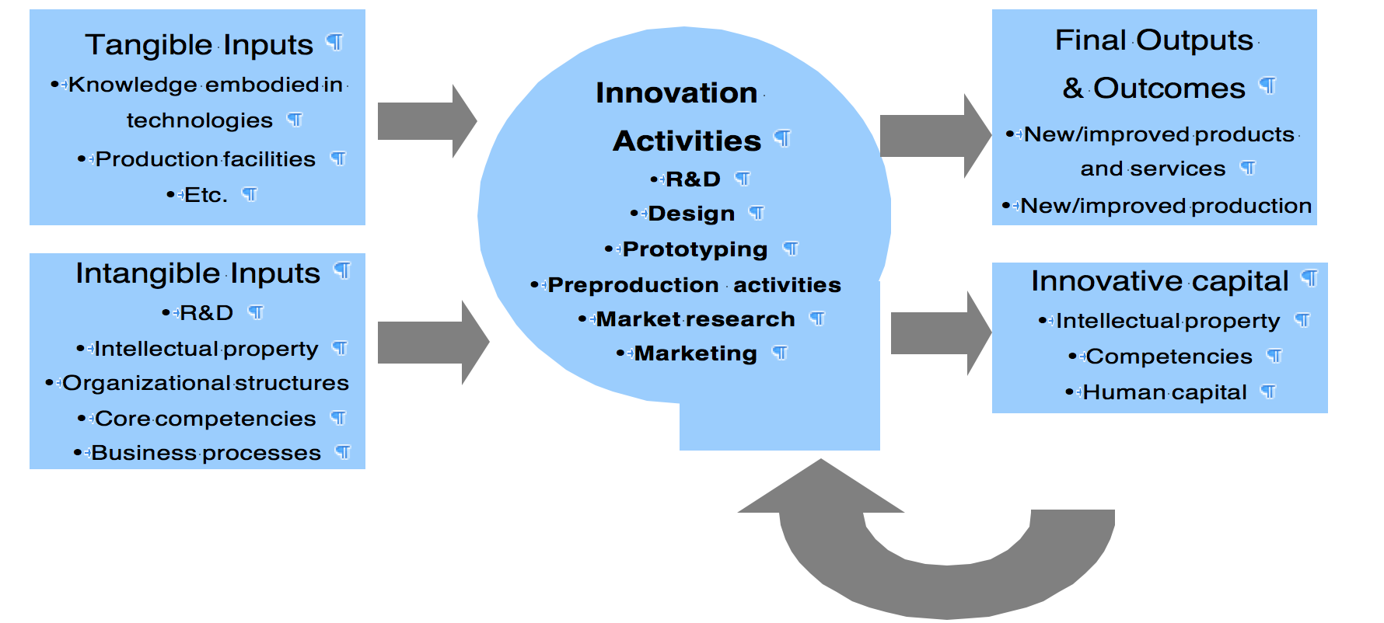
Innovation – Tangible and Intangible Inputs & Outputs
Notes:
Innovation is driven by a firm’s (or any entity’s) investment in tangible capital (such as computer networks) or intangible capital (such as organizational structure or human capital/training). These innovative activities could lead to tangible outputs (e.g., new or improved products or processes) or intangible ones (e.g., more experienced employees, who are more likely to engage in future innovations).

Slide 5
Measuring Inputs to Business Innovation
Human capital refers to the knowledge, skills, and competencies of individuals.
Intellectual capital refers to the knowledge and technological capabilities of the firm, such as intellectual property (patents, copyrights, and trade secrets), databases, software, and equipment that lead to specialized technological capabilities, and including human capital, organizational knowledge, and information stored in institutional databases.
Organizational or structural capital encompasses processes, databases, software, and organizational competencies.
Relational capital refers to relationships with external stakeholders, including customers and suppliers.

Slide 6
EU Community Innovation Surveys – 4 Types
Product and services with characteristics, capabilities, and intended uses that differ significantly from existing products
Processes involving production methods, logistics systems, and support services that are intended to improve the quality, efficiency, and flexibility of production and logistics
Organizational changes relating to firm structure, management strategies, or external relations that are intended to improve the use of knowledge, quality of production and services, or efficiency
Marketing strategies, including new and improved marketing and sales methods that involve changes in product design, packaging, product placement, and product promotion and pricing.

Slide 7
Why is NSF Interested in Measuring Innovation?
NSF’s mission is "to promote the progress of science …..
National Center for Science and Engineering Statistics (NCSES) – NSF’s statistical agency
    NCSES role - collect, interpret, analyze, and disseminate objective data on the science and engineering enterprise:
    Research and Development and Innovation
    The science and engineering workforce
    U.S. competitiveness in science, engineering, technology, and R&D
    The condition and progress of STEM education in the United States

Slide 8
Research Questions –
Capturing and Measuring Innovation
What are persistent and emerging trends that affect innovation?
How do other countries and organizations measure innovative activity and innovation investments? Are they using or beginning to use non-traditional sources of data?
How do companies measure innovative activities, investments, outputs, and outcomes? How can administrative data be leveraged? What new survey questions could be developed to help companies better respond to the NSF surveys?

Slide 9
Research Questions –
Administrative and Opportunity Date
What can be learned from opportunity data about innovation capacity and innovation outcomes? How does innovation capacity present itself through company websites, portal, and blogs?
What methods and modeling are needed to adapt and use administrative and opportunity data where there is insufficient information about the relationship of the data sources to the statistical events to be described?

Slide 10
Examples of Research Questions –
What do Companies Tell Us Publically?
Does the public trail of a company’s news releases, social media, blog discussions, press coverage and interviews, conference activities, collaborative activities, funding inquiries, and other business action provide insight into the company’s innovativeness
What activities and structures are most indicative of the beginning of business startup, the development of innovative capacity, and innovative performance?

Slide 11
Examples of Innovation Research Topics
Amateur innovation (crowd sourcing/crowdfunding)
Non-traditional S&T Workforce
Tracking innovation in elementary and high school - How is innovation taught?
Track S&T competitions, business plan competitions, celebrity entrepreneurs
Foundations funding innovation
Scientific repositories
Public health innovation
Notes:
Data visualization/emerging trends – network theory (EM)
Amateur innovation (crowd sourcing/crowdfunding) – (EM/JG)
R&D collaboration across firms – collaboration networks (private versus social welfare/benefits) (GK)
Non-traditional S&T Workforce (EM/KZ) – online courses; LinkedIn; etc.
Suppose you could follow data for a sample of individuals to answer these questions? (contract for a sample of data)
Tying innovation to education – what are educational pathways to innovation?
What kinds of entrepreneurial businesses are created? LLC? Other? (KZ)
How do you track innovation in elementary and high school? How is innovation taught? (MO)
DEKA – Dean Kamen
Data on university incubators (National Assns to gather data; Crunchbase; ) (VL)
Peter Thiel – 2 year $100K to drop out of school and work on S&T areas
Track S&T competitions, business plan competitions, celebrity entrepreneurs (VL)
UK NESTA - UK documents their trends
Alternative finance – crowdfunding
Financing for women – are they seeking funding in new ways?
Ways people to get money to innovate –
Are there Foundations funding innovation? There appears to be a growing amount of this funding to support R&D. There is a lot of young wealth (Arnold Foundation) and old wealth (RWJF)
Social innovation –
Open Source Software and Data – see notes
Scientific repositories – does this lead to more R&D and innovation?
DOD categorizes research as 6.1 to 6.9 – how to look at the data for categorizing?
(Also TRL1 system ………)
How does the internet change innovation? Internet world – how to measure innovation? e.g. Measure clicks? Web metrics? Apps innovation?
Types of government funding of innovation supporting …
MIT Top 100 and other categorizations of emerging trends ….
Public Health Innovation – trickle down exacerbates disparities – what is the outcome? e.g. does it change obesity?
Psychology – defining originality and creativity?

Slide 12
Examples of Innovation Research Topics
What role do these play in innovation?
Open Source Software and Data
How does innovation capacity present itself through company websites, portal, blogs, company websites and other public materials; e.g. news stories, SEC filings, company reports, other?
What are sources of funding that lead to innvoation, e.g. Foundations?
STEM Workforce – professional Masters; MOOC certification; other ways to capture
Notes:
Data visualization/emerging trends – network theory (EM)
Amateur innovation (crowd sourcing/crowdfunding) – (EM/JG)
R&D collaboration across firms – collaboration networks (private versus social welfare/benefits) (GK)
Non-traditional S&T Workforce (EM/KZ) – online courses; LinkedIn; etc.
Suppose you could follow data for a sample of individuals to answer these questions? (contract for a sample of data)
Tying innovation to education – what are educational pathways to innovation?
What kinds of entrepreneurial businesses are created? LLC? Other? (KZ)
How do you track innovation in elementary and high school? How is innovation taught? (MO)
DEKA – Dean Kamen
Data on university incubators (National Assns to gather data; Crunchbase; ) (VL)
Peter Thiel – 2 year $100K to drop out of school and work on S&T areas
Track S&T competitions, business plan competitions, celebrity entrepreneurs (VL)
UK NESTA - UK documents their trends
Alternative finance – crowdfunding
Financing for women – are they seeking funding in new ways?
Ways people to get money to innovate –
Are there Foundations funding innovation? There appears to be a growing amount of this funding to support R&D. There is a lot of young wealth (Arnold Foundation) and old wealth (RWJF)
Social innovation –
Open Source Software and Data – see notes
Scientific repositories – does this lead to more R&D and innovation?
DOD categorizes research as 6.1 to 6.9 – how to look at the data for categorizing?
(Also TRL1 system ………)
How does the internet change innovation? Internet world – how to measure innovation? e.g. Measure clicks? Web metrics? Apps innovation?
Types of government funding of innovation supporting …
MIT Top 100 and other categorizations of emerging trends ….
Public Health Innovation – trickle down exacerbates disparities – what is the outcome? e.g. does it change obesity?
Psychology – defining originality and creativity?

Slide 13
Measuring Funding of Innovation
What are private sources of funding? What is distribution of funding across these sources? (or could just focus on one sources)
Angel Investors
Venture Capitalists
Corporate Venture Capitalists
Incubators, e.g. 1776 in Arlington, university incubators, other
Business competitions at universities
Foundations
Other?
Reference: Branscomb, Lewis M. and Philip E. Auerswald, Between Invention and Innovation: An Analysis of Funding for Early-Stage Technology Development, NIST GCR 02-841, Gaithersburg, MD, November 2002.
Notes:
http://www.insidephilanthropy.com/home/2016/3/10/meet-the-50-most-powerful-women-in-us-philanthropy.html

Slide 14
Measuring Value of Open Source Software and Data
Open account software is counted in the national accounts based on the labor inputs attributed to each industry, best measured in the business sector. What useful statistics can be measured?
How do open source software and databases link to institutions? To different sectors?
References: Daniel Katz, U of Chicago
Notes:
See SciSIP emails from April 2015
Neil Chue Hong (U. Edinburgh & Software Sustainability Institute) and I are the track chairs for the Economics of Software & Services Track in the 12th International Conference on Economics of Grids, Clouds, Systems and Services (GECON 2015) - http://www.gecon-conference.org/gecon2015 - 15-17 September 2015, Cluj-Napoca, Romania
The description of our track in the CFP is:
Software has become an essential element of information technology (IT) systems, whether scientific, technical, academic, industrial, commercial, local, distributed, or social. Elements of software form an ecosystem, with new elements entering over time, and various elements being combined with each other and with computing, networking, and data elements within IT systems. Economics and economic models can be applied at many levels, including the overall software ecosystem, and to model the relationship between software and other parts of the IT system.
In this track, we are interested in new understandings of how software ecosystems and IT systems interrelate, including:
· development of novel economic models around software
· the use of existing economic models to gain new understanding
· the role of incentives, both novel and existing
· comparative understanding of software in distinct classes of IT systems
· business models, including revenue & pricing
· the role of economics in software development models
· community development and interaction within software ecosystems
· economic models which optimise software quality or software adoption
With this email, we request both those interested in volunteering as Program Committee members for our track to let us know of their interest, and that potential authors begin considering submissions to the track and to the conference. Papers will be due May 25.
Thanks,
Dan
--
Daniel S. Katz
University of Chicago
(773) 834-7186 (voice)
(773) 834-6818 (fax)
d.katz@ieee.org or dsk@uchicago.edu
http://www.ci.uchicago.edu/~dsk/
· OSS reports that they survey UK institutions on this. See: http://oss-watch.ac.uk/studies/survey2013/ict_policy_and_procurement_practice
Dan
On Feb 27, 2015, at 1:36 PM, James Howison <jhowison@ischool.utexas.edu> wrote:
Great question. I'm working on a research agenda on the "other direction" of technology transfer; rather than commercialization, I'm focusing on transfer of originally grant funded work to community support models, including open source software development. There are a ton of differences between successfully running a grant-funded project and successfully running a community-supported open project (software or otherwise); the transition is as complicated and interesting as commercialization. Happily we know a decent amount about the end point (open source organization and online communities), so the research is on the transitions. I describe this in a work in progress paper I'm presenting at the Information School's conference: http://james.howison.name/pubs/HowisonInfrastructureTransitions-in-progress.pdf
I've chatted with a few people in technology transfer offices and it's like talking to corporate people about open source in the late 1990s. There is sometimes real opposition to it and, at best, a shrug that it's probably fine for things with no value. The idea that open code can be the basis of an ecosystem that brings reputation, funding and, indeed, profit, to the University seems a fair distance away. But I'd love to chat with tech transfer (or VP research types) who see succeeding at open source as a strategic goal worthy of university support.
In answer to the specific question, these resources might be useful. The UK has some of the best resources in these areas: http://oss-watch.ac.uk/ There's also the UK Scientific Software Sustainability Institute http://www.software.ac.uk/resources/get-speed Looking through things there, I'm not seeing anything specifically about University IP policies, but I'll ping them on Twitter and see if anything comes up.
--James
On Fri, Feb 27, 2015 at 11:43 AM, Dana Bostrom ‪<dbostrom@aamc.org>‬ wrote:
I’m not aware of any “studies” but I can tell you as someone who did tech transfer at universities for 12 years that open source is supported by most (if not all) universities. I’ve never seen it referenced in an IP policy, but that may be because some software is considered a personal work in the same way that journal articles are. Some software is written by a huge team and becomes an institutionally owned work, but other times it is personal and can be distributed according to the individual author’s wishes.
Over a decade ago, the University of Washington distributed bioinformatics software Phred / Phrap and associated software open source for a decade and sold “services” associated with it. I managed the IP for the Pine email client software which was distributed open source. Universities still support open source.
Dana
Dana Bostrom
Executive Director
Data Commons, LLC

Slide 15
A disciplined approach is needed to develop the theory and methods for using All data
SDAL Research Model
Data Framework
Case Studies
Data Source Discovery, Inventory, and Access
Research Questions and Literature Review
Data Quality, preparation, and integration
Statistical Modeling and Data Analyses
Lessons Learned Using Multiple data sources and types
Analysis of Research Questions

Slide 16
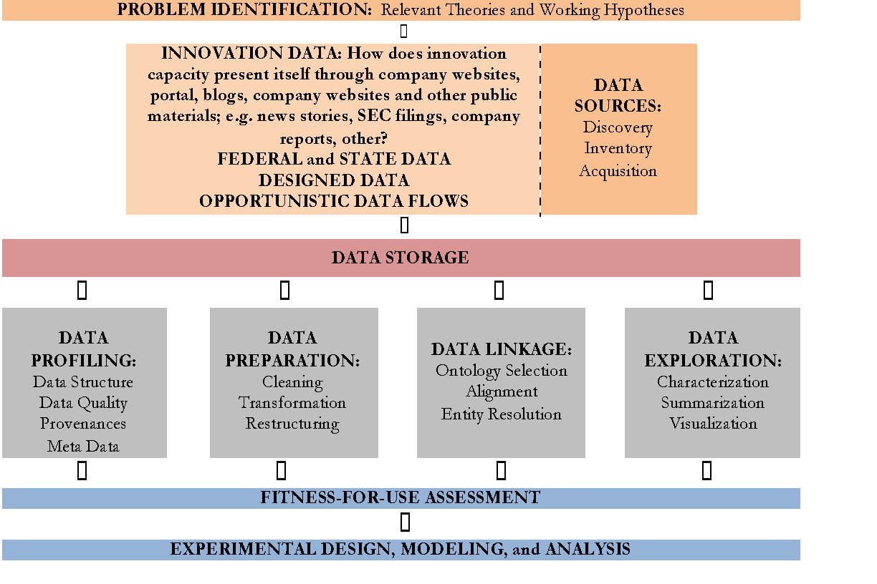
GAIN
INSIGHTS
ASSESSMENT
DEVELOP
INTERVENTIONS

Slide 17
Application to Measuring Innovation
Start with research questions
Data source discovery, data inventory, and data acquisition
Data profiling, data preparation, and data linkage
Data exploration and modeling and analysis to benchmark new sources of data and use in analysis

Slide 18
Documents to Read
NSF NCSES White Paper - Improving our Understanding of Catalysts for Innovation – Measuring Innovation in New Ways
Literature
CNSTAT folder: Gault, von Hippel, others
Literature folder:
Must reads folder (which also includes the white paper)
Measuring Innovation – A Business Perspective

